Slide 1
Databases with R: A Marriage Made in the Tidyverse
Patrick Mathias
API R 2024

Slide 2
Session | Instructor
Database Concepts Demystified | Joe Rudolf, MD
Databases with R: A Marriage Made in the Tidyverse | Patrick Mathias, MD, PhD
Joining Forces: Data Merging Techniques in R | Amrom Obstfeld, MD, PhD
Getting Your Feet Wet with Clinical Research Data with REDCap and R | Stephan Kadauke, MD, PhD

Slide 3
Goal: Use database connection tools in R to extract and manipulate data
Objectives
Connect to and explore the tables of a database using the DBI package
Apply dplyr functions to extract and manipulate data from a database
Summarize data from within a database

Slide 4


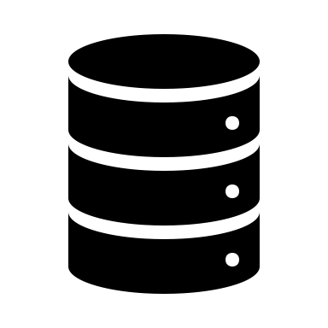

Goal: Connect to database from RStudio to perform analysis without exporting data
Application (RStudio)
Computer
Database
(Internal or External)
Working Memory

Slide 5
Connecting with Relational Databases
DBI package provides functions to connect to and perform operations on DBs
odbc package utilizes Open Database Connectivity (ODBC) drivers to connect with various types of SQL databases
RSQLite package houses driver information specific to SQLite connections

Slide 6
Exercise 1
Run the setup chunk to load the packages we need to connect to databases

Slide 7
First Step: Connect to a Database
connection object
driver
con <- dbConnect(drv = driver_function,
…)
additional connection options (file, user, pass, etc.)
Notes:
Recall that an object is like a storage unit
Can hold a variety of different entities within an object, e.g. a number, a string, a data frame

Slide 8
Connect to a SQLite Database
connection object
driver
con <- dbConnect(drv = RSQLite::SQLite(),
dbname = "file_name.db")
file to connect to
(writes file if it doesn’t exist)
https://rsqlite.r-dbi.org/reference/sqlite
Notes:
For this dbConnect function, the driver argument is telling R what type of database you want to connect to
This weird looking function here is just the full name for the SQLite() function
The two colons in front of the function are used to explicitly refer to the package that function comes from

Slide 9
Consider where your database lives
con <- dbConnect(drv = RSQLite::SQLite(),
dbname = “file_name.db”)
What is your working directory? (If using a notebook what directory does the file live in?)
Is your database in the same directory? If not, you must provide a path.
https://rsqlite.r-dbi.org/reference/sqlite

Slide 10
List the tables in the database
connection object
dbListTables(conn = con)
https://rsqlite.r-dbi.org/reference/sqlite

Slide 11
List the fields in a table
connection object
table name
dbListFields(conn = con, name = "sample")
https://rsqlite.r-dbi.org/reference/sqlite

Slide 12
Disconnect from the database when not actively using it
active connection object
dbDisconnect(con)

Slide 13
Exercise 2
First identify your working directory.
Then connect to MIMIC database by building a connection object named "mimic“ that connects to the mimic.db file in the main directory. How can you confirm you are connected?
List the tables in the mimic database.
List fields from LABEVENTS and D_LABITEMS tables

Slide 14
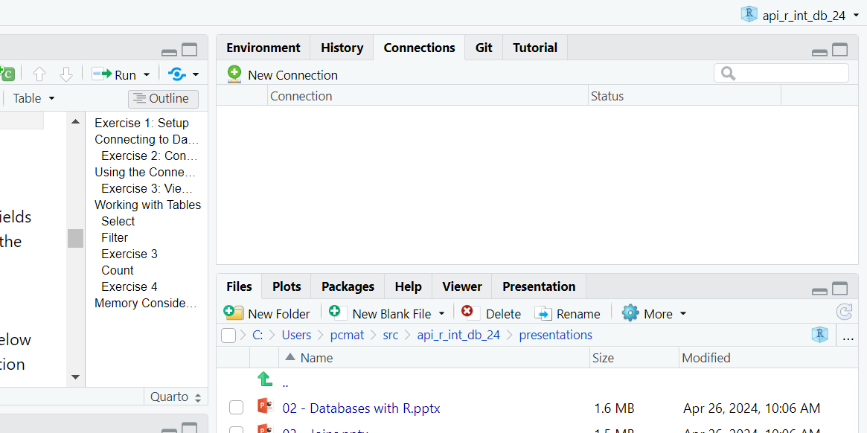
RStudio provides tools to view and manage database connections

Slide 15
Use the connections package to fully utilize RStudio functionality
library(connections)
connection_view(con)
connection object to display
in connections window

Slide 16
Exercise 3
Enable the view of the mimic SQLite database in the Connections pane and use the pane to answer:
If we are interested in reviewing details about laboratory test results, which tables would we be interested in?
How many fields are in the d_labitems table of the database?

Slide 17
Connect to a Specific Table
database connection object
equivalent to data frame
table_object <- tbl(connection_object,
"table_name")
database table to query

Slide 18
Connect to a Specific Table
database table to query
equivalent to data frame
d_labitems <- tbl(mimic, "d_lab_items")
database connection object

Slide 19
Creation of table objects does not automatically bring data into RStudio
Application (RStudio)
d_labitems <- tbl(mimic, "d_lab_items")
Database
(Internal or External)
lazy evaluation = only when needed
Notes:
When R Studio connects to the database when this table object is created, no data is actually pulled into the environment
R is aware of the connection and can pull data if needed, but does not
Referred to as “lazy evaluation” the data is only analyzed when needed

Slide 20
Functions that generate output will query the database and bring data into RStudio
Application (RStudio)
d_labitems <- tbl(mimic, “d_lab_items”)
head(d_labitems, 10)
Database
(Internal or External)
Working Memory

Slide 21
Exercise 4
Create a table object labevents that connects to the labevents table in the mimic database. Use the head() function to review the first 100 rows of the table. Are there any variables that would help to interpret the data but are missing?

Slide 22
The DPLYR Package supports a wide range of data manipulation activities
ƒ(
)
ƒ(
)
ƒ(
)

Slide 23
The Select() Function ACts Like the Select Operator for Databases
Extract specific columns/variables
= number of rows
↓ number of columns

Slide 24
Select Captures Specific Variables
select(table_object, variable_1, variable_2)
name(s) of columns to extract
(or a select helper) function)
data frame to transform
data frame to transform

Slide 25
Select Captures Specific Variables
table connection object
variable_subset <- select(d_labitems,
itemid, label)
name(s) of columns to extract

Slide 26
Select Captures Specific Variables
select(d_labitems, -category)
Adding “-” drops variables rather than includes them

Slide 27
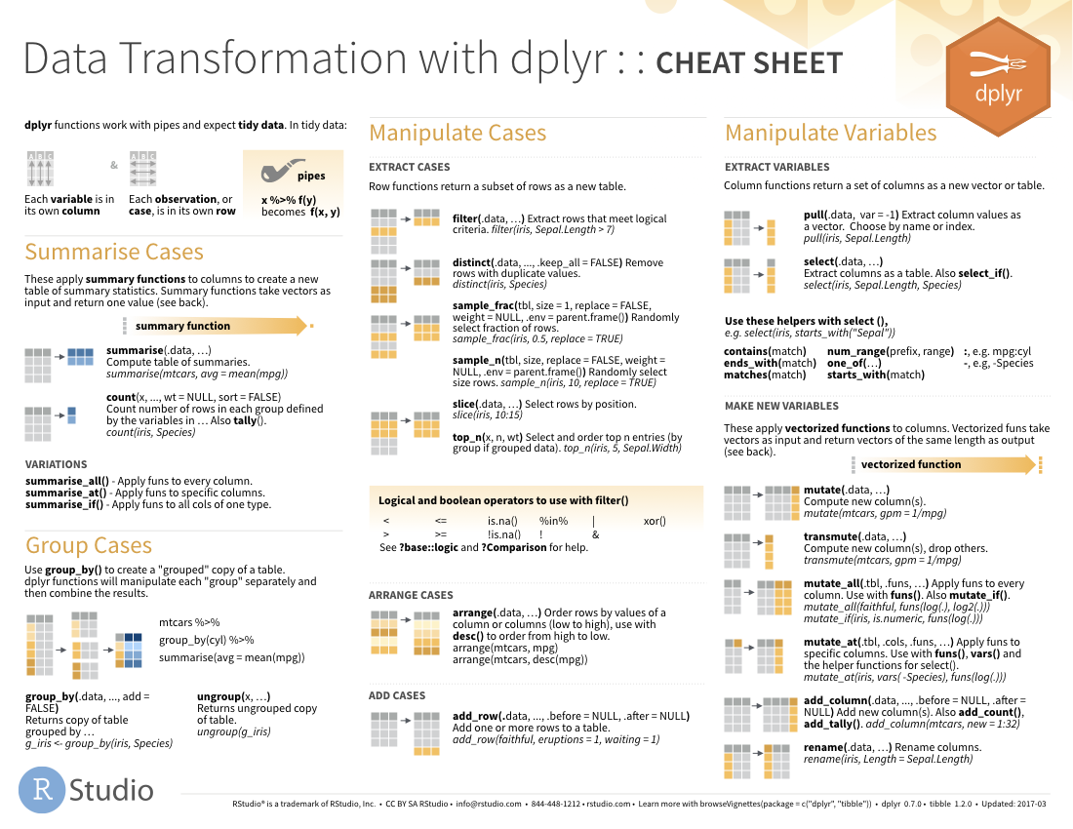
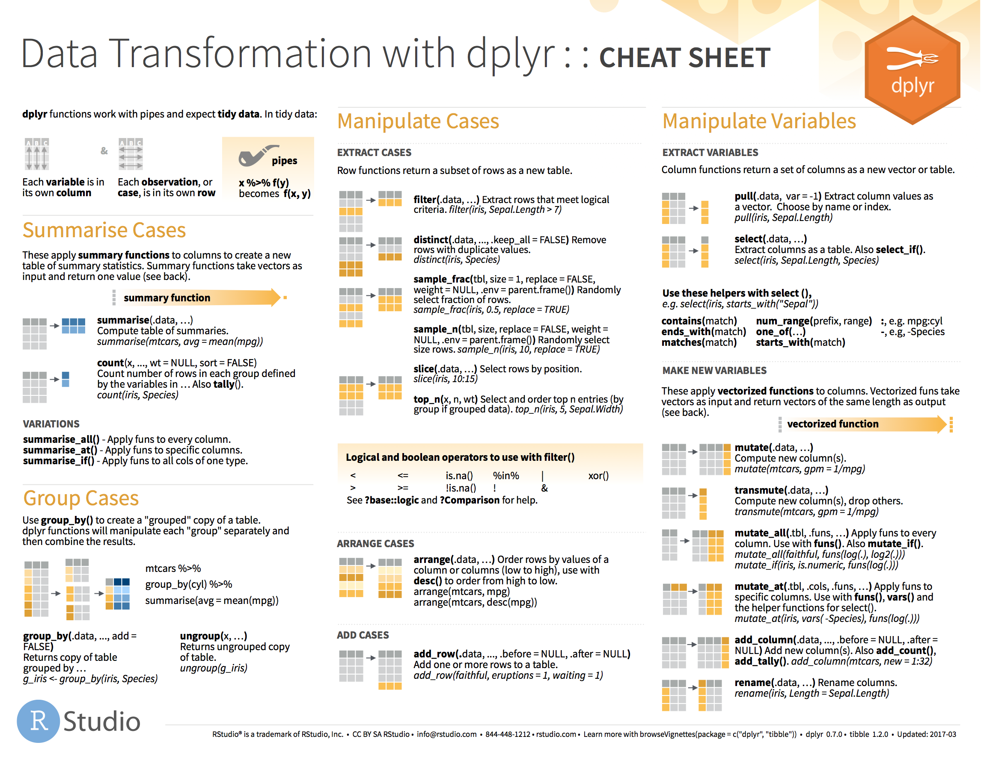
Helper Functions Support Complex Selections
27

Slide 28
The Filter() Function Acts Like a Where Clause in a SQL Statement
↓ number of rows
= number of columns
Extract rows that meet logical criteria

Slide 29
Filter Captures Specific Rows
filter(data,... )
one or more logical tests (filter returns each row for which the test is TRUE)
data frame to transform
 |  |  | FALSE
 |  |  | FALSE
 |  |  | TRUE
 |  |  | FALSE
 |  |  | TRUE
 |  |  | FALSE

Slide 30
Filter Captures Specific Rows
filter(data, column_name == criteria )
one or more logical tests (filter returns each row for which the test is TRUE)
 |  |  | FALSE
 |  |  | FALSE
 |  |  | TRUE
 |  |  | FALSE
 |  |  | TRUE
 |  |  | FALSE

Slide 31
Filter Captures Specific Rows
filter(d_labitems, label == “Glucose”)
index | itemid | label
30 | 52442 | Lactate
31 | 50818 | pCO2
32 | 50828 | Ventilator
33 | 50809 | Glucose
index | itemid | label
33 | 50809 | Glucose
FALSE
FALSE
FALSE
TRUE

Slide 32
Filter Captures Specific Rows
Values coded as character strings must be surrounded by quotes
filter(d_labitems, label == “Glucose”)
index | itemid | label
30 | 52442 | Lactate
31 | 50818 | pCO2
32 | 50828 | Ventilator
33 | 50809 | Glucose
= sets
(returns nothing)
== tests if equal
(returns TRUE or FALSE)
FALSE
FALSE
FALSE
TRUE

Slide 33
Logical Tests Commonly Used with Filter()
x < y | Less than
x > y | Greater than
x == y | Equal to
x <= y | Less than or equal to
x >= y | Greater than or equal to
x != y | Not equal to
x %in% y | Group membership
is.na(x) | Is NA
!is.na(x) | Is not NA

Slide 34
The Pipe (|> ) Helps Organize Sequential Data Manipulation Activities
d_labitems
|>
filter(____, label == “Glucose”)
filter(d_labitems, label == “Glucose”)
d_labitems |> filter(label == “Glucose”)

Slide 35
The Pipe (|> ) Helps Organize Sequential Data Manipulation Activities
glucose_events <- labevents|>
filter(itemid == 50809) |> # itemid for Glucose
select(subject_id, specimen_id, itemid, value, valueuom)
Sequence filter() and select() to create a subset of the data

Slide 36
Exercise 5
Using select() and filter() (and pipes), create a subset of data from the labevents data frame that includes lactate observations (itemid 50813) and the following variables: specimen_id, value, ref_range_lower, ref_range_upper. Use the head() function to review the first rows of the table.

Slide 37
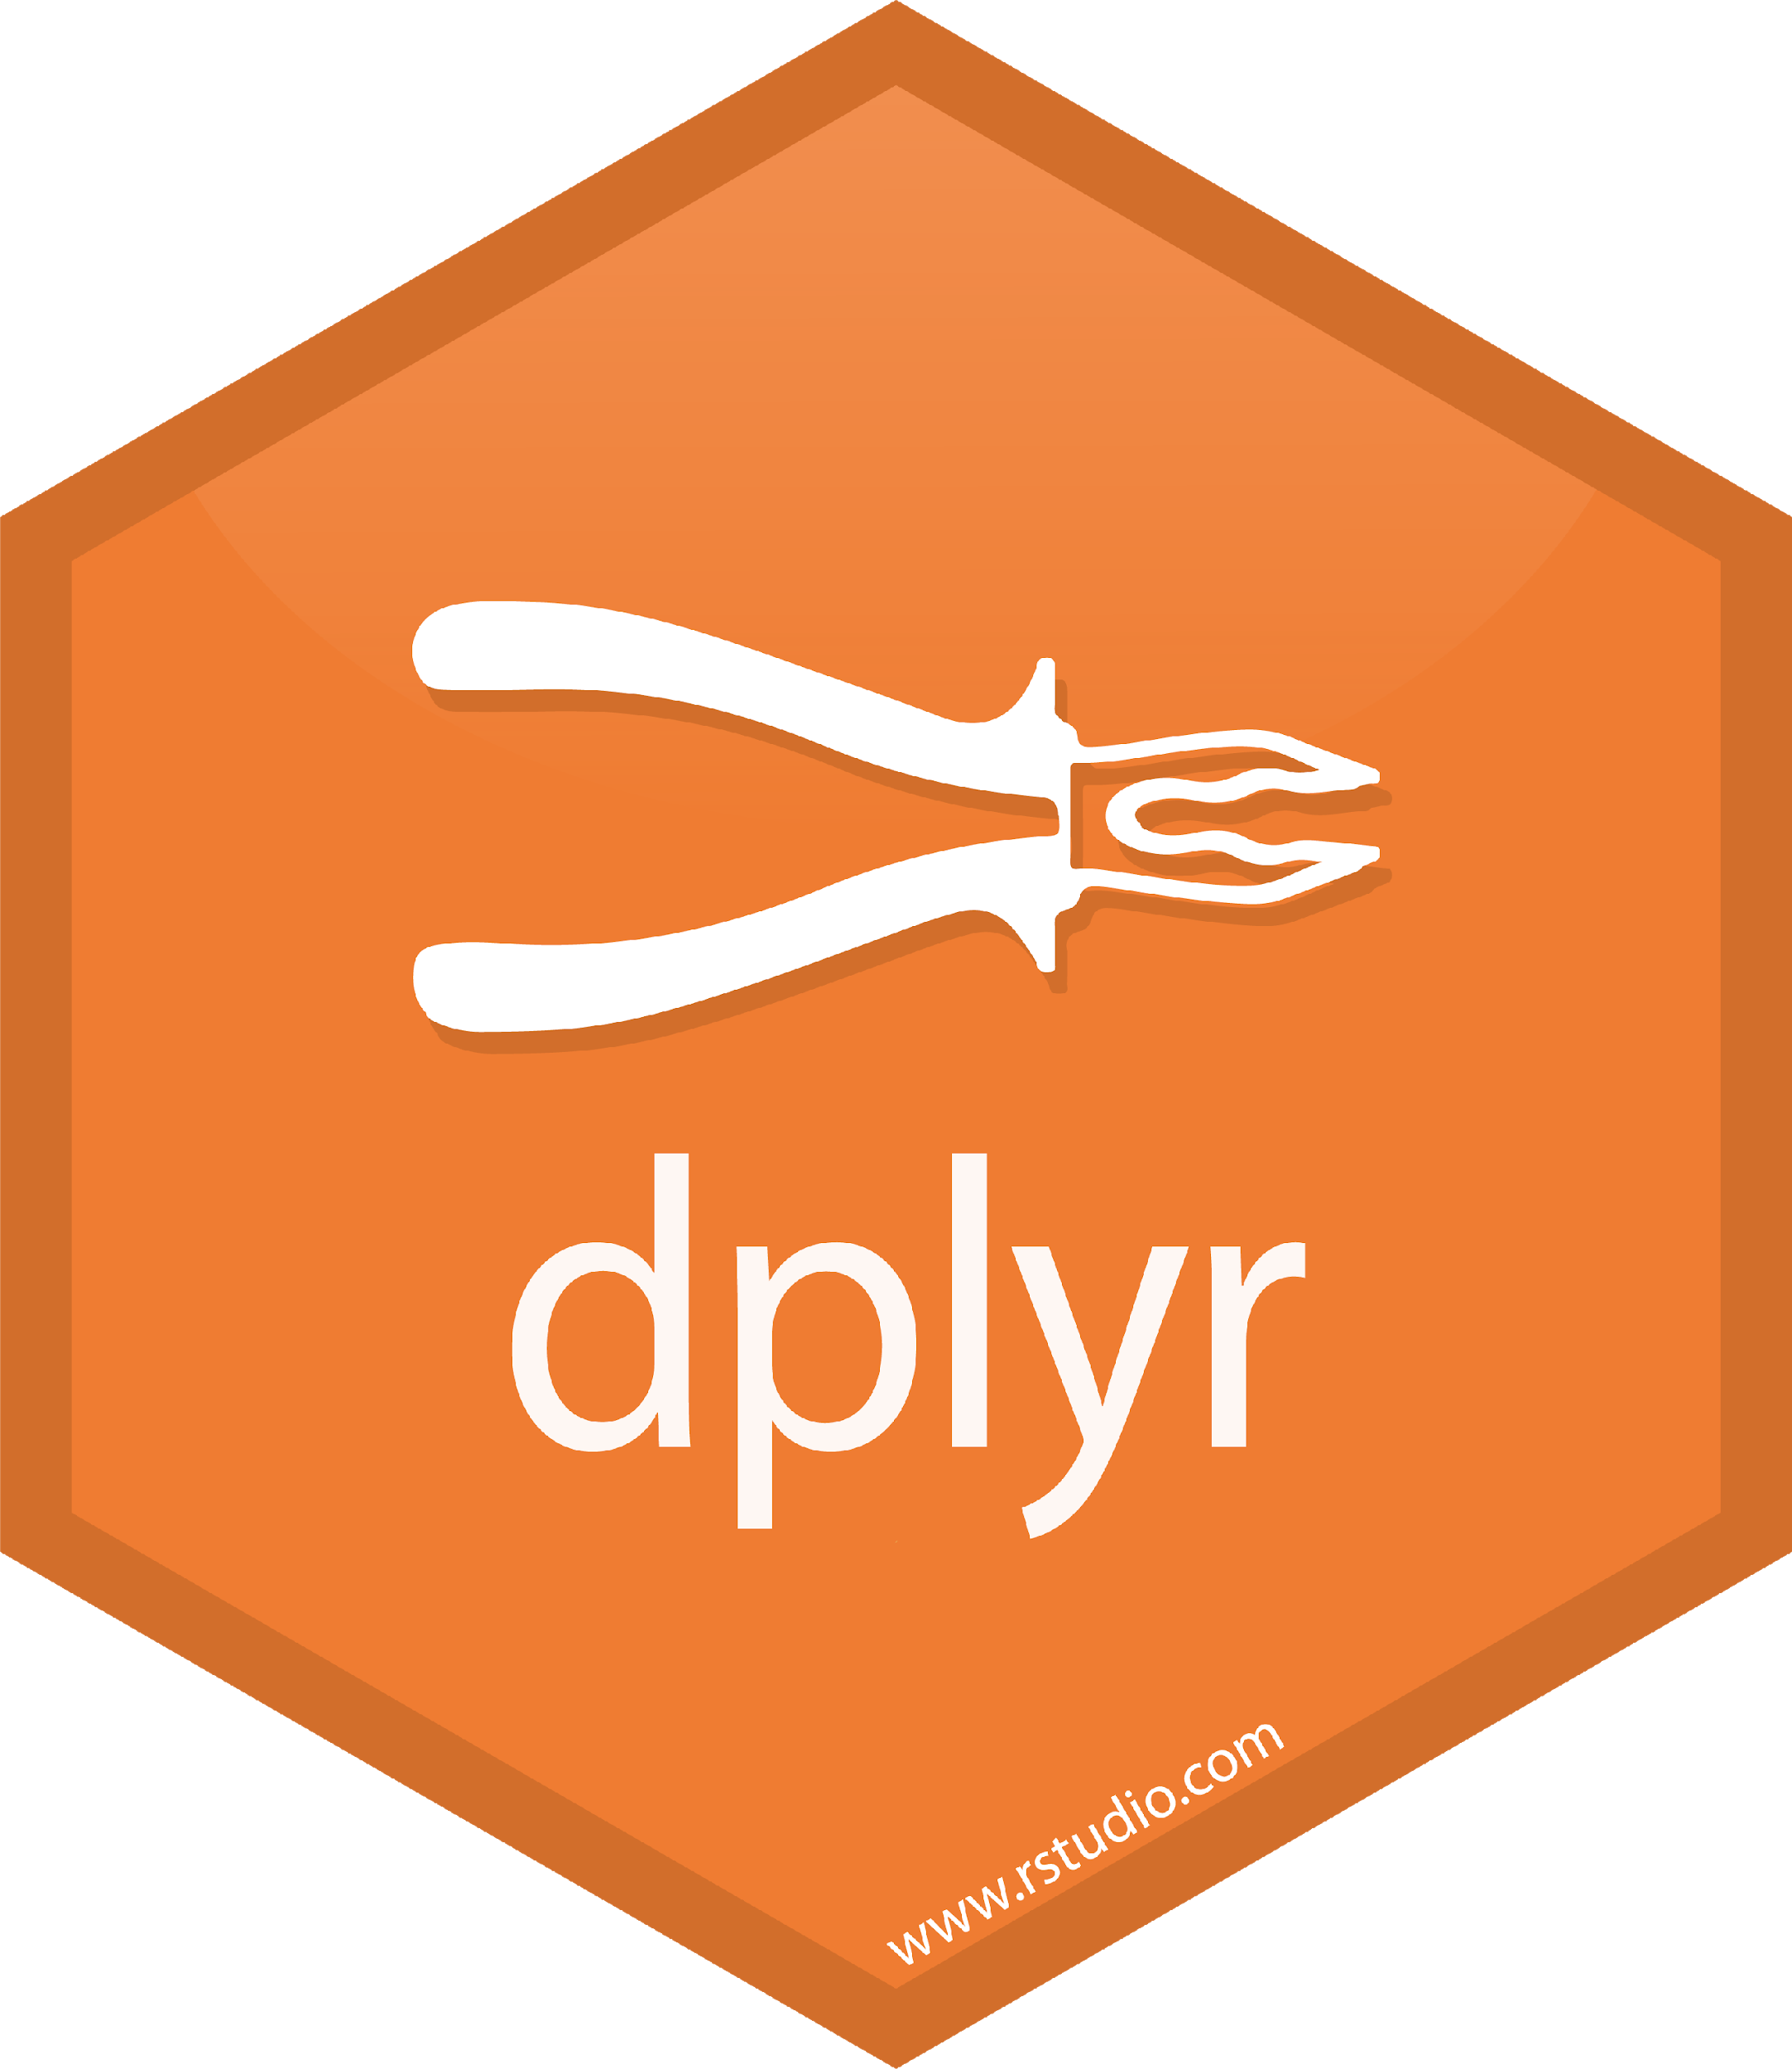
group_by()
|>
summarize()
Make summaries of your data by group
Notes:
Just like we can apply summarize() to a full data frame, we can apply summarize() to each group separately.
The combination of group_by() and summarize() is extremely powerful.

Slide 38
group_by() |> summarize()
Make summaries of your data
labevents|>
group_by(itemid) |>
summarize(test_count = n())
itemid | value
51277 | 3.3
51279 | 20
52172 | 98
51277 | 1.5
itemid | test_count
51277 | 2
51279 | 1
52172 | 1
Notes:
Adding group_by(), we count how many rows there are for each `pan_day`.
This is the data that underlies the figure we looked at in slide 6.

Slide 39
count ()
Count by one or more variables: equivalent to group by and summarize with n()
labevents|>
count(itemid)
itemid | value
51277 | 3.3
51279 | 20
52172 | 98
51277 | 1.5
itemid | n
51277 | 2
51279 | 1
52172 | 1
Notes:
Adding group_by(), we count how many rows there are for each `pan_day`.
This is the data that underlies the figure we looked at in slide 6.

Slide 40
Exercise 6
Using count() generate a new table object tests_per_subject that shows the number of labevents per subject_id. View the first 100 rows of the table.

Slide 41
dbplyr works in the background to translate your dplyr into SQL
glucose_events <- labevents|>
filter(itemid == 50809) |> # itemid for Glucose
select(subject_id, specimen_id, itemid, value, valueuom)
R
SELECT subject_id, specimen_id, itemid, value, valueuom
FROM labevents
WHERE itemid = 50809
SQL

Slide 42
dbplyr works in the background to translate your dplyr into SQL
labtest_counts <- labevents|>
count(itemid)
R
SELECT itemid, COUNT(*) AS n
FROM labevents
GROUP BY itemid
SQL

Slide 43
show_query() will display the SQL
labtest_counts <- labevents|>
count(itemid) |>
show_query()
<SQL>
SELECT `itemid`, COUNT(*) AS `n`
FROM `labevents`
GROUP BY `itemid`

Slide 44
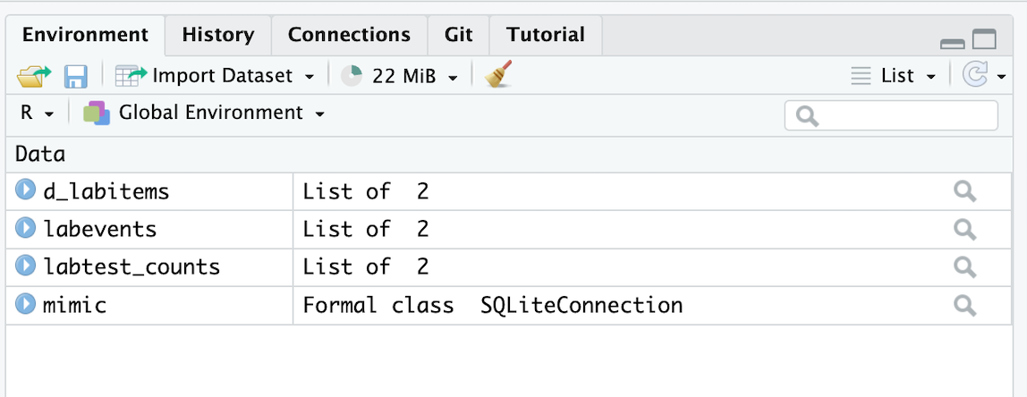
collect() will retrieve data into a data frame
labtest_counts <- labevents|>
count(itemid)
table object

Slide 45
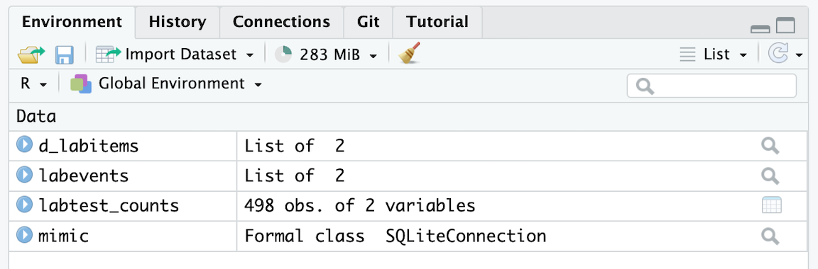
collect() will retrieve data into a data frame
labtest_counts <- labevents|>
count(itemid) |>
collect()
data frame

Slide 46
Disconnecting from the database
dbDisconnect(con)
connection object
Close the connection when done with your work – particularly if you are running a script

Slide 47
Summary
The DBI package provides functions that allow you to connect to databases from within RStudio
The connections package supports browsing of your database within the Rstudio Connections tab
After connecting to a database, table objects can be created and manipulated similarly to data frames
A package called dbplyr works in the background to translate dplyr functions into queries executed on the database
Only specific activities will retrieve query results into memory, which makes it possible to interact with large databases without overwhelming your working memory

Slide 48
Goals and Objectives
Connect to and explore the tables of a database using the DBI package
Apply dplyr functions to extract and manipulate data from a database
Summarize data from within a database

